Slide 2
Agenda

Slide 3
Transaction Classification: The Idea

Slide 4
Transaction Classification: How It Works
TIM HORTONS 887 PURCHASE
Raw Transaction Data
Preprocessing
Classification Model
Categorized Output
“Dining”

Slide 5
Transaction Classification: UI

Slide 6
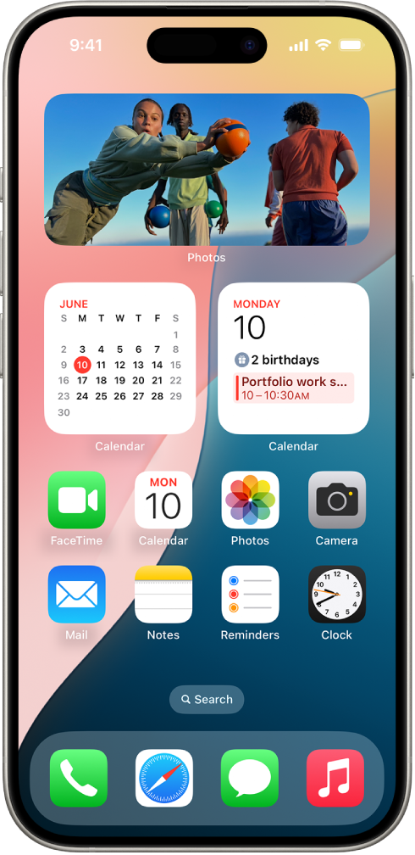
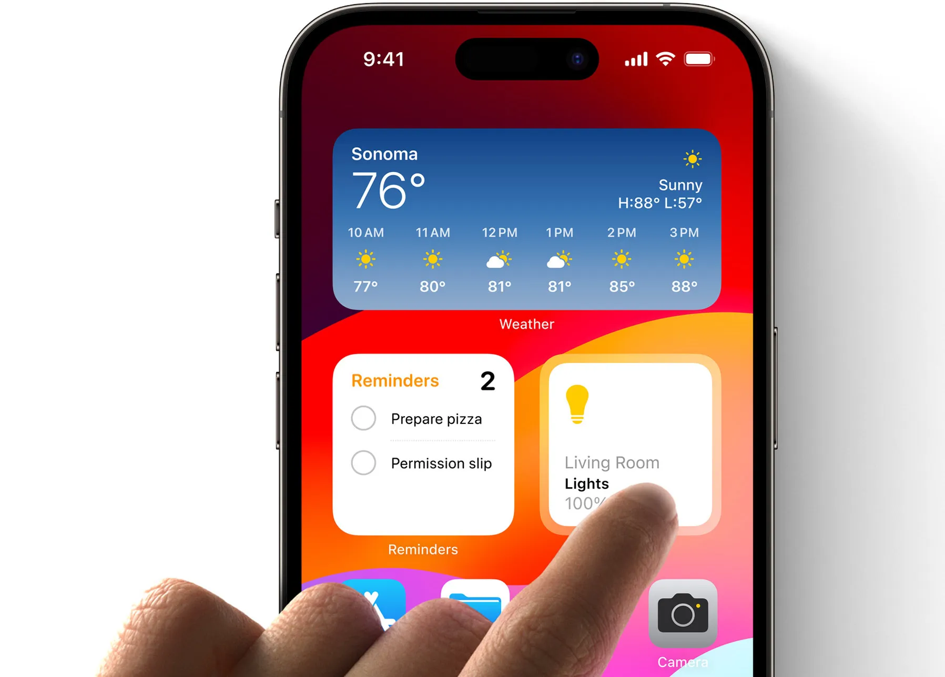
What are Widgets?
A new way to do mobile banking at a glance.

Slide 7
Migrating from Today Extensions
WidgetKit
Screenshots of our current TodayExtensions.
Compatible with iOS 16+

Slide 8
Account Preview Widgets

Slide 9
Demo: Account Preview Widgets

Slide 10
Demo: Account Preview Widgets

Slide 11
Scheduled Payments Widgets

Slide 12
Supporting iOS 16 & 17+

Slide 13
What’s Next: Lock Screen Widgets

Slide 14
What’s Next: Adding More Interactivity

